Slide 1

Class10
CSC 495/583 Topics of Software Security ROP & Return-to-libc Attack
Dr. Si Chen (schen@wcupa.edu)

Slide 2
Review

Slide 3
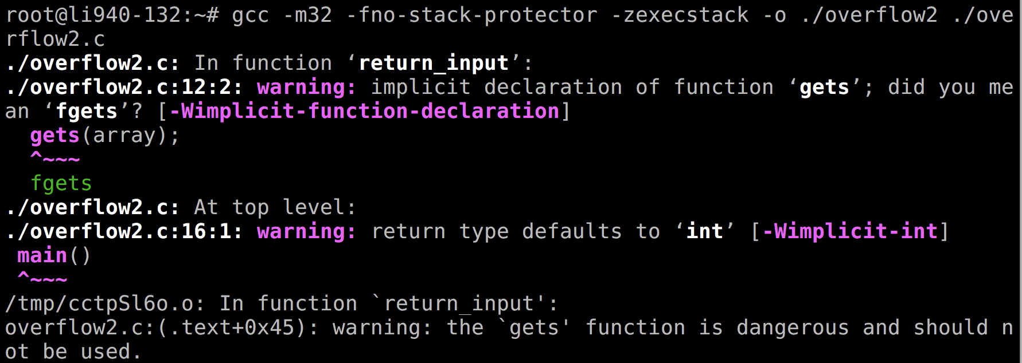
Compile the code
gcc -m32 –fno-stack-protector –zexecstack –o ./overflow2 ./overflow2.c

Slide 4
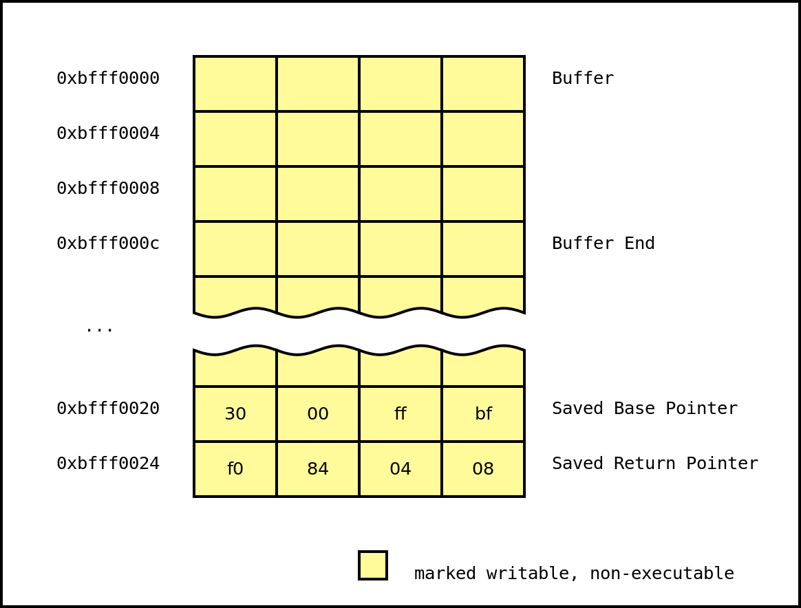
No eXecute (NX)
-zexecstack
Also known as Data Execution Prevention (DEP), this protection marks writable regions of memory as non-executable.
This prevents the processor from executing in these marked regions of memory.

Slide 5
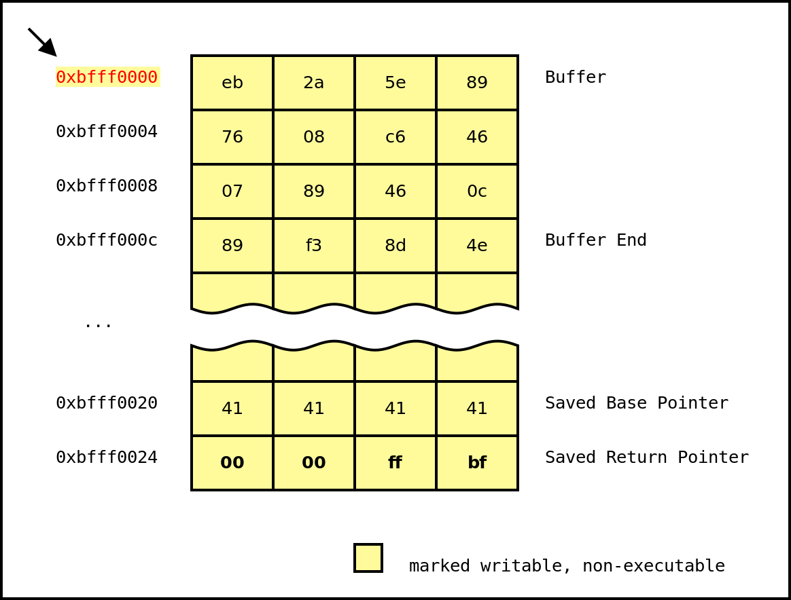
No eXecute (NX)
Thus, the attacker's exploit is thwarted.

Slide 6
Data Execution Prevention (DEP): No eXecute bit (NX)
NX bit is a CPU feature
–
On Intel CPU, it works only on x86_64 or with Physical Address Extension (PAE) enable
Enabled, it raises an exception if the CPU tries to
execute something that doesn't have the NX bit set
The NX bit is located and setup in the Page Table Entry

Slide 7
Return-oriented programming
(ROP)

Slide 8
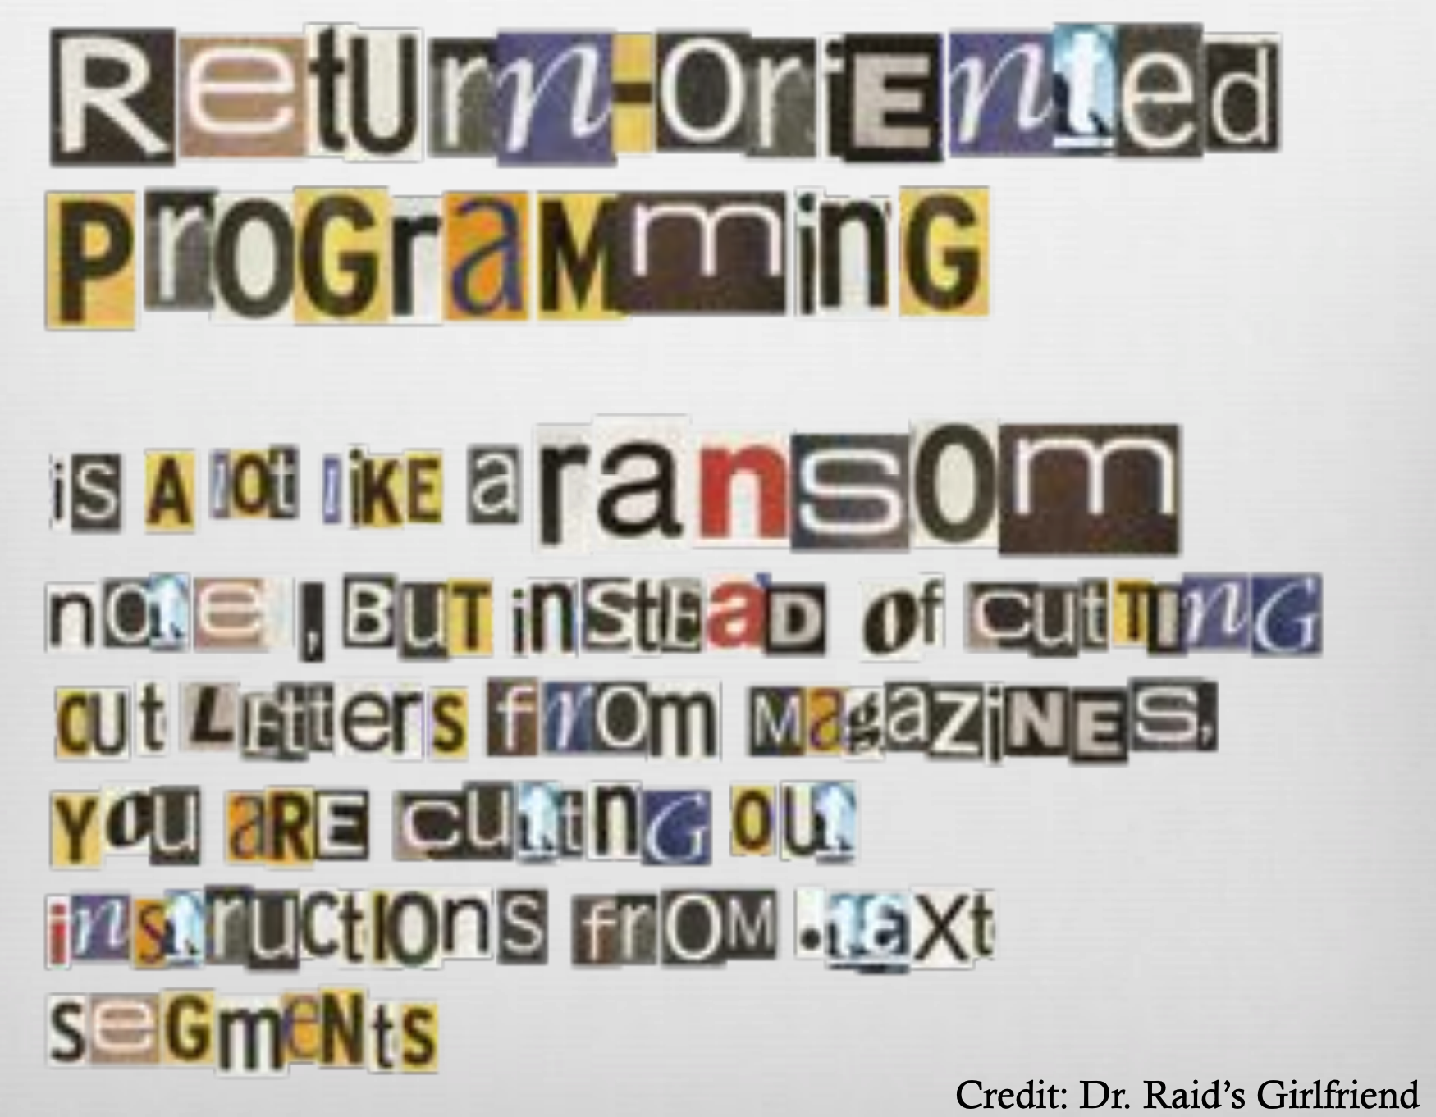

Slide 9
ROP: The Main Idea

Slide 10
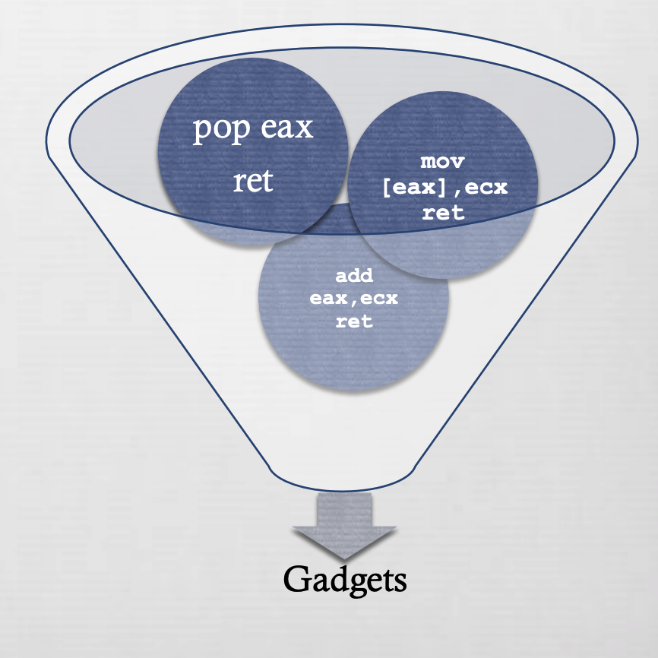
ROP: Gadget
Various instruction sequences can be combined to form gadgets
Gadgets perform higher level actions
Write specific 32-bit value to specific memory location
Add/sub/and/or/xor value at memory location with immediate value
Call function in shared library
https://recon.cx/2010/slides/mac-os-x_roe.pdf

Slide 11
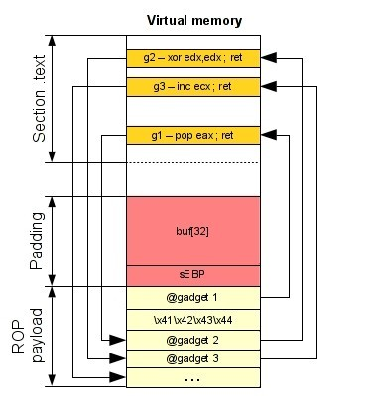
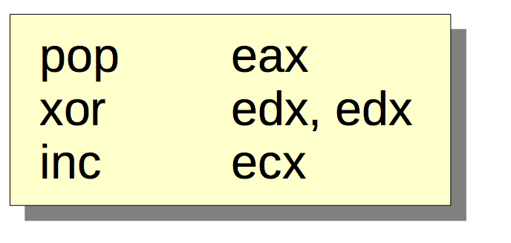
Attack Process on x86
Gadget1 is executed and returns
Gadget2 is executed and returns
Gadget3 is executed and returns
●
So, the real execution is:

Slide 12
How can we ﬁnd gadgets?
Several ways to find gadgets
Old school method : objdump and grep
Some gadgets will be not found: objdump aligns instructions
Make your own tool which scans an executable segment
Use an existing tool
Any instruction sequence ending in “ret” is useful — could be part of a gadget

Slide 13
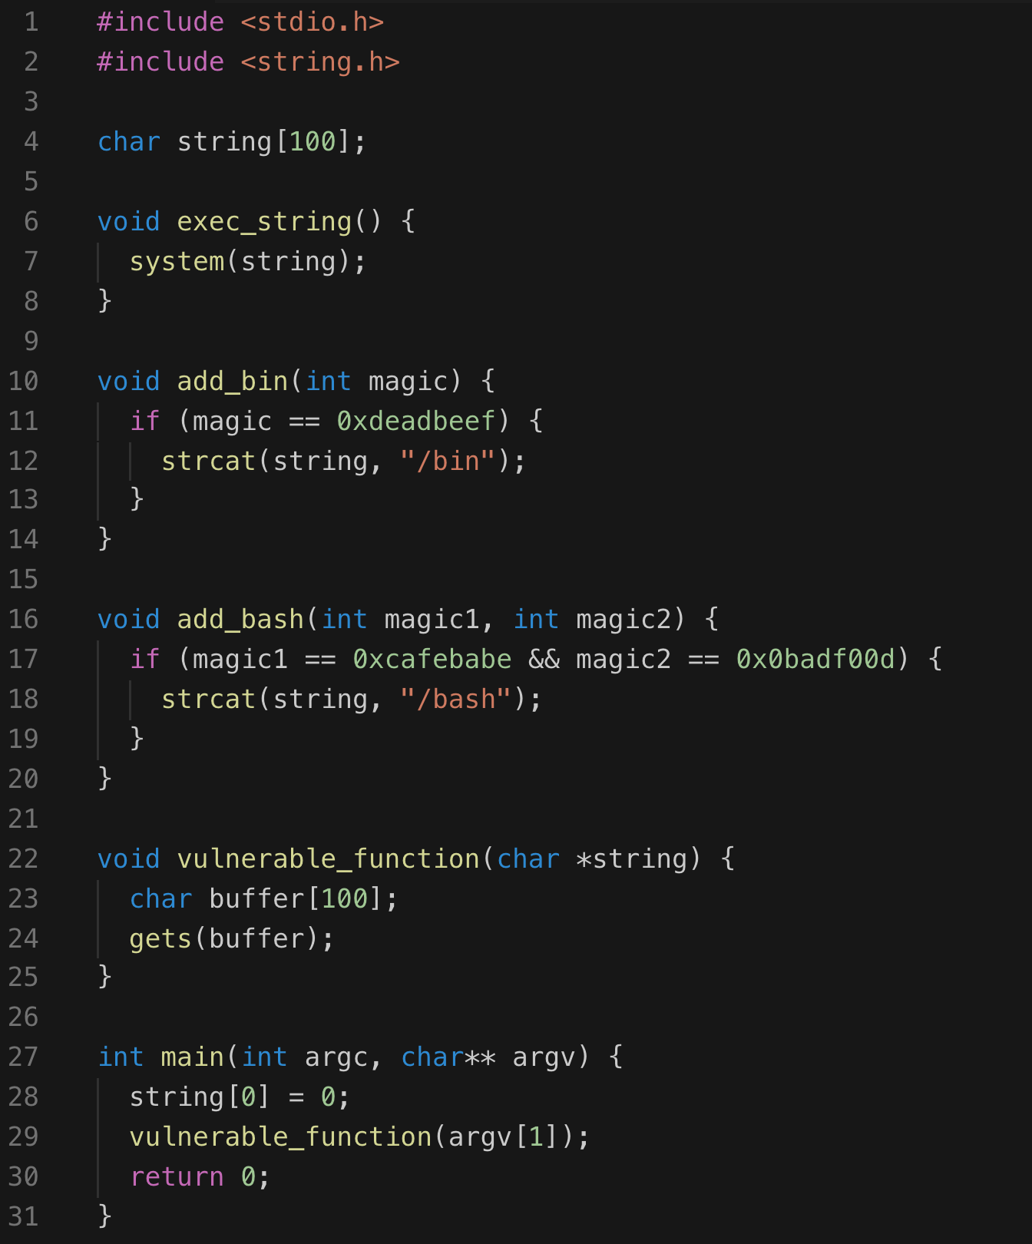
Execution Path
main()
→ vulnerable_function (hacked)
→ add_bin()
add_bash()
exec_string()
Spawn shell

Slide 14
x
Execution Path
add_bin()
magic == 0xdeadbeef
add_bash()
magic1 == 0xcafebabe
magic2 == 0x0badf00d
exec_string()
Spawn shell

Slide 15
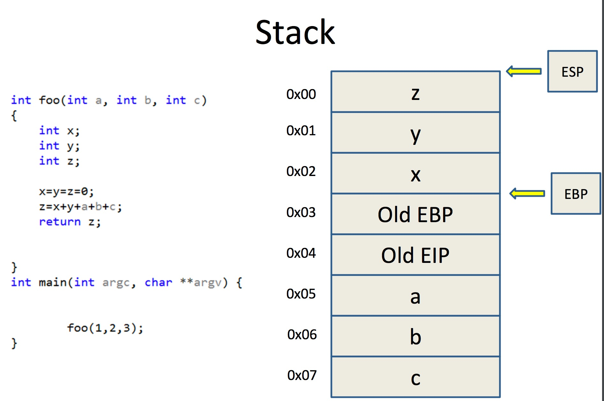
Basic Structure of
Return Chaining

Slide 16
Return Chaining
Function Address
Return Address (Old EIP)
Arguments

Slide 17
Return Chaining
Execution Path
Without parameters, the ROP chain
looks much simpler
main()
→ vulnerable_function (hacked)
→ add_bash()
add_bin()
exec_string()
Spawn shell
Add_bin()
Add_bash()
Exec_string()
Similarly to lab1, we use gdb to adjust the length of the dummy characters to trigger buffer overflow
Dummy Character “A”s
Address for Add_bin()
Address for Add_bash()
Address for exec_string()

Slide 18
Return Chaining
Execution Path
add_bin()
magic == 0xdeadbeef
add_bash()
magic1 == 0xcafebabe
magic2 == 0x0badf00d
exec_string()
Spawn shell
For add_bin(), we need to pass 0xdeadbeef,
So the ROP chain looks like:
Add_bin()
Add_bash()
Exec_string()
magic == 0xdeadbeef
Function Address
Return Address (Old EIP)
Arguments
Dummy Character “A”s
Address for Add_bin()
Address for Add_bash()
0xdeadbeef
Address for exec_string()
Broken link

Slide 19
Return Chaining
Execution Path
The previous ROP chain does not work, because argument
0xdeadbeef is still on the stack, we need to find a way to ”clean” it
add_bin()
magic == 0xdeadbeef
add_bash()
magic1 == 0xcafebabe
magic2 == 0x0badf00d
exec_string()
Spawn shell
Add_bin()
Add_bash()
Exec_string()
magic == 0xdeadbeef
Solution: use a pop, ret gadget to push the argument 0xdeadbeef into a register to remove it from the stack
Dummy Character “A”s
Address for Add_bin()
Address for pop_ret
0xdeadbeef
Address for Add_bash()

Slide 20
Return Chaining
Execution Path
For add_bash(), we need to pass 0xcafebabe and 0x0badf00d,
So we need to pop twice to remove both of them from the stack
add_bin()
magic == 0xdeadbeef
add_bash()
magic1 == 0xcafebabe
magic2 == 0x0badf00d
exec_string()
Spawn shell
Add_bin()
Add_bash()
Exec_string()
magic1 == 0xcafebabe
magic2 == 0x0badf00d
Dummy Character “A”s
Address for Add_bin()
Address for pop_ret
0xdeadbeef
Address for Add_bash()
Address for pop_pop_ret
0xcafebabe
0x0badf00d

Slide 21
Return Chaining
Execution Path
Finally, call exec_string()
add_bin()
magic == 0xdeadbeef
add_bash()
magic1 == 0xcafebabe
magic2 == 0x0badf00d
exec_string()
Spawn shell
Add_bin()
Add_bash()
Exec_string()
Dummy Character “A”s
Address for Add_bin()
Address for pop_ret
0xdeadbeef
Address for Add_bash()
Address for pop_pop_ret
0xcafebabe
0x0badf00d
Address for exec_string()

Slide 22
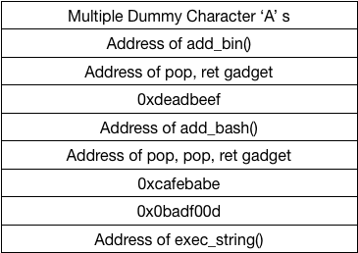

Slide 23
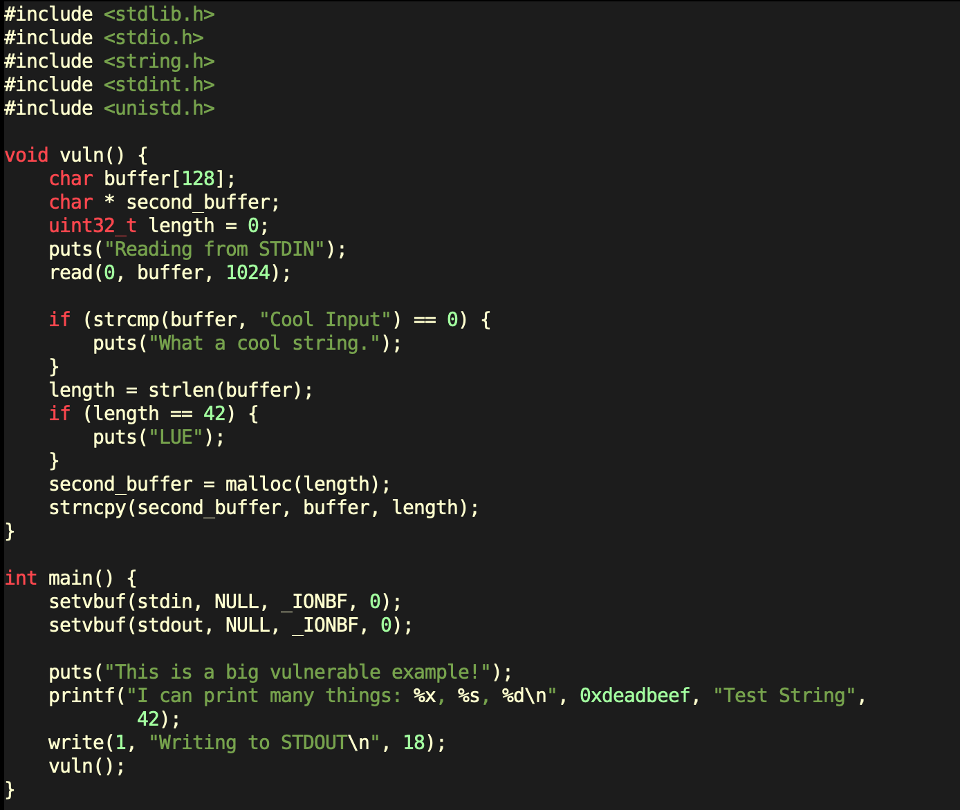
rop2.c
Since the binary is not big enough to give us a decent number of ROP gadgets, we will cheat a bit and compile the binary as a statically linked ELF.
This should include library code in the final executable and bulk up the size of the binary.

Slide 24
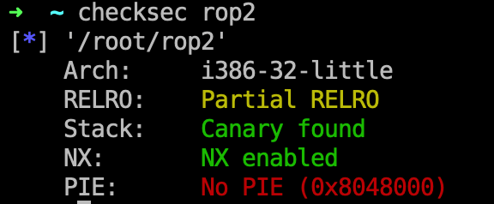
rop2.c
Since the binary is not big enough to give us a decent number of ROP gadgets, we will cheat a bit and compile the binary as a statically linked ELF.
This should include library code in the final executable and bulk up the size of the binary.

Slide 25
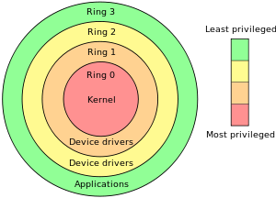
Linux Syscalls
Linux system calls or syscalls are interfaces between the user space application and the Linux kernel.
Functionality performed by the Linux kernel can be invoked by placing parameters into the right registers and passing control to the interrupt vector 0x80 using the int 0x80 opcode. Typically, this is not done by the program directly but by calling glibc wrappers.

Slide 26
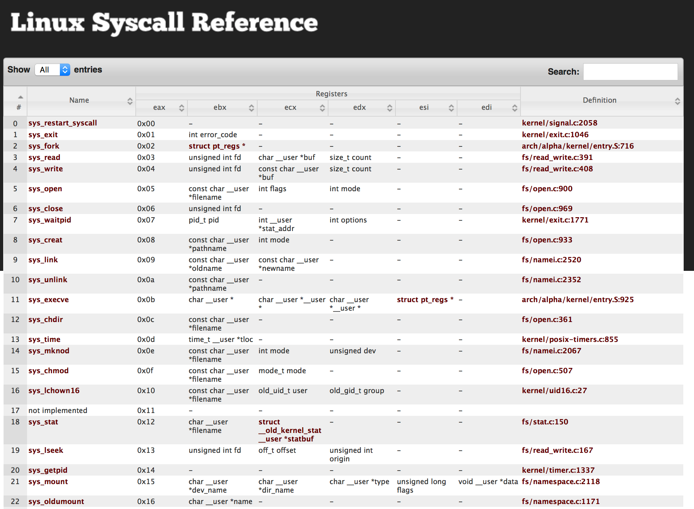
Linux System Call
http://syscalls.kernelgrok.com

Slide 27
Linux System Call
Typically, we invoke this function in the following manner to spawn shells.
execve("/bin/sh", {0}, {0})

Slide 28
Linux System Call
f we take a look at the syscall reference, we can see that some parameters are expected in the eax, ebx, ecx, and edx registers.
eax - holds the number of the syscall to be called
ebx - a pointer to the string containing the file name to be executed
ecx - a pointer to the array of string pointers representing argv
edx - a pointer to the array of string pointers representing envp
For our purposes, the value that each of the registers should contain are:
eax = 0xb
ebx = "/bin/sh"
ecx = memory address -> 0
edx = memory address -> 0

Slide 29
ROPgadget

Slide 30
ret2libc Attack

Slide 31
Introduction
“Getting around non-executable stack (and fix)”, Solar Designer (BUGTRAQ, August 1997)
https://seclists.org/bugtraq/1997/Aug/63
The ret2libc and return oriented programming (ROP) technique relies on overwriting the stack to create a new stack frame that calls the system function.

Slide 32
ret2libc Attack
We were able to pick from a wealth of ROP gadgets to construct the ROP chain in the previous section because the binary was huge.
Now, what happens if the binary we have to attack is not large enough to provide us the gadgets we need?
One possible solution, since ASLR is disabled, would be to search for our gadgets in the shared libraries loaded by the program such as libc.
However, if we had these addresses into libc, we could simplify our exploit to reuse useful functions. One such useful function could be the system() function.

Slide 33
libc
C standard library
Provides functionality for string handling, mathematical computations, input/output processing, memory management, and several other operating system services
<stdio.h>
<stdlib.h>
<string.h>
However, if we had these addresses into libc, we could simplify our exploit to reuse useful functions. One such useful function could be the system() function.
→ find System() function’s address

Slide 34
Ret2lib Shellcode Structure
Function Address
Return Address (Old EIP)
Arguments
Dummy Characters
Address for System() in libc
Address for Exit() function in libc (if you want to exit the program gracefully)
Address for Command String (“e.g. /bin/sh”)

Slide 35
Glossary of Terms
ASLR (Address Space Layout Randomization): Security measure in modern OSes to randomize stack and libc addresses on each program execution.
Binary: A binary is the output file from compiling a C or C++ file. Anything in the binary has a constant address.
Canary: A canary is some (usually random) value that is used to verify that nothing has been overrwritten. Programs may place canaries in memory, and check that they still have the exact same value after running potentially dangerous code, verifying the integrity of that memory.
NX (Non-Executable): Security measure in modern OSes to separate processor instructions (code) and data (everything that's not code.) This prevents memory from being both executable and writable.
ROP (Return Oriented Programming): Reusing tiny bits of code throughout the binary to construct commands we want to execute.
Stack: The stack is part of the memory for a binary. Local variables and pointers are often stored here. The stack can be randomized.
libc: A binary is dynamically linked and has a libc file. This means that the whole set of standard library functions are located somewhere in the memory used by the program.

Slide 36
Q & A

